Slide 1


HP Banda 218008480
Mobile clinic Software presentation

Slide 2
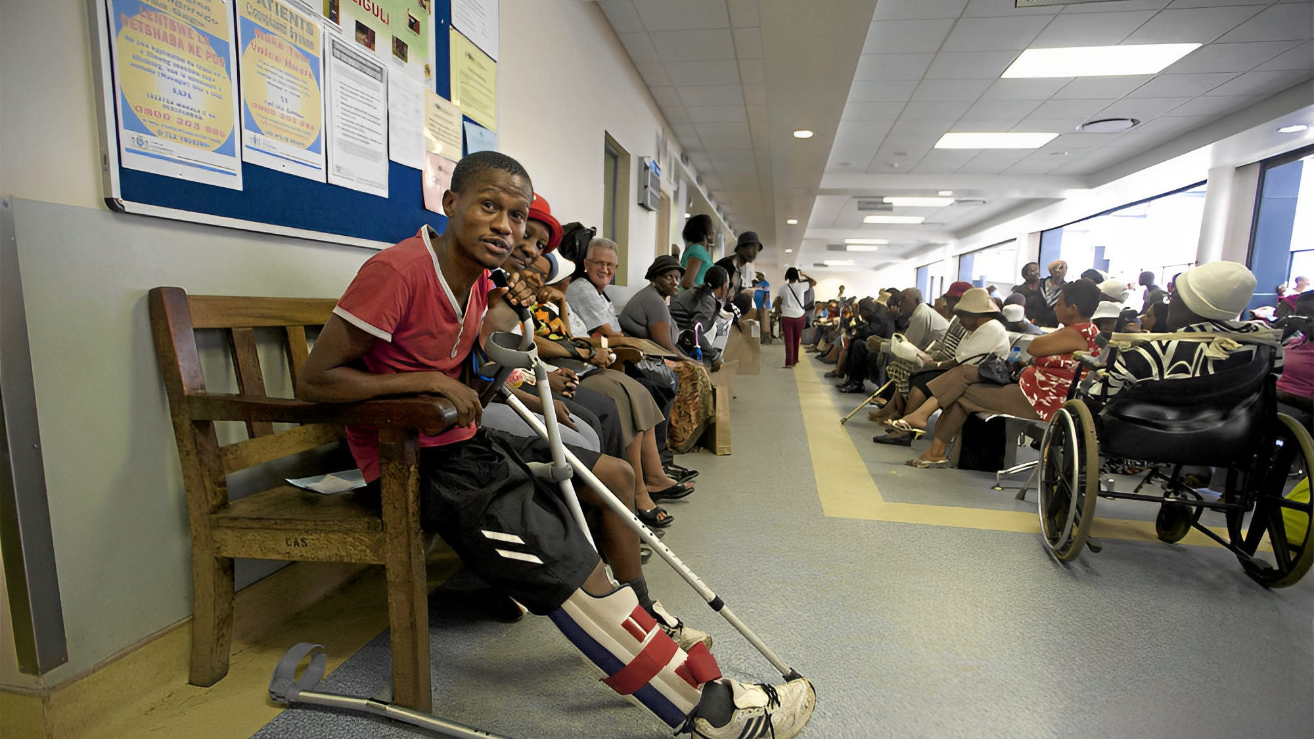

Problem
South Africa is facing various socio-economic challenges, including high unemployment, poverty, inequality, and limited access to public services.
One major issue is the difficulty of accessing healthcare services in rural areas.

Slide 3
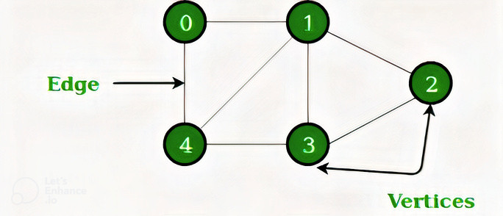
Solution
A potential solution is to use graph algorithms to optimize the deployment of mobile clinics, which can provide medical services to people in remote areas.

Slide 4
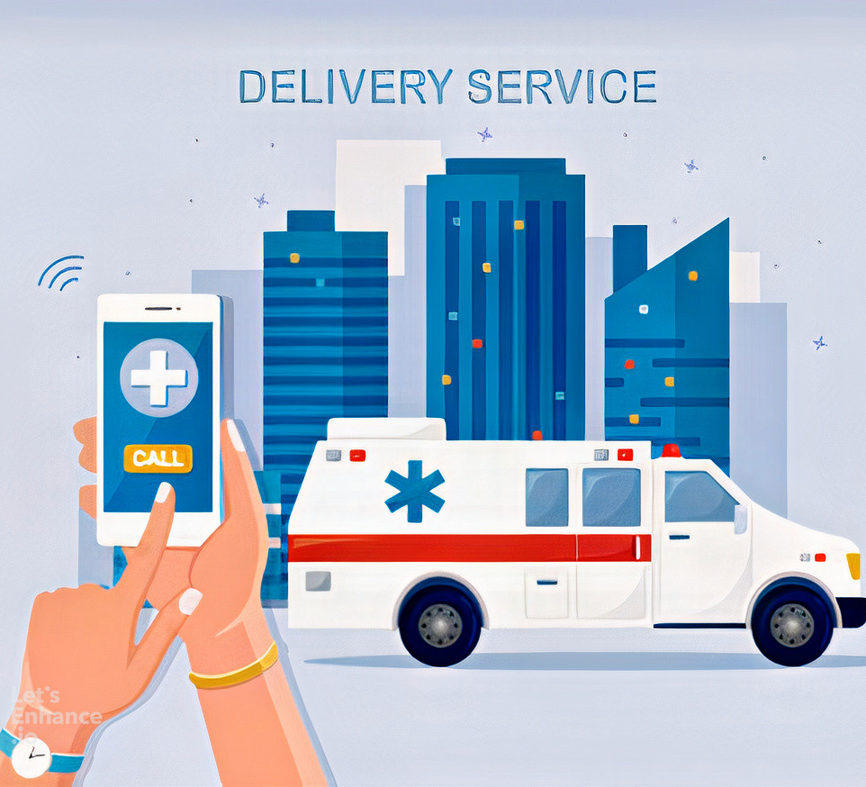
Proposed Solution
Mobile clinics are vehicles that are equipped with medical equipment and staffed with healthcare professionals who can provide medical services to people in remote or underserved areas. They can help address the healthcare challenges in rural areas by providing primary healthcare services, preventative care, and referrals to specialists.

Slide 5
Proposed Solution
The Java program will consist of two main components: an admin panel and a user panel. The admin panel will allow administrators to add or delete mobile clinics from the system. The user panel will allow users to search for mobile clinics based on their location and request a mobile clinic to visit their area.
To optimize the deployment of mobile clinics, the program will use graph algorithms to determine the shortest path between the mobile clinics and the users' locations. The program will represent the locations of mobile clinics and users as vertices on a graph, and the distance between them as edges. The program will use Dijkstra's algorithm to find the shortest path between a user's location and the closest mobile clinic.
When a user searches for mobile clinics in their area, the program will display a list of the mobile clinics closest to their location, along with their distance and availability. The user can then select a mobile clinic and request a visit. Once the request is confirmed, the program will update the availability of the mobile clinic and schedule a visit to the user's location.
In summary, the Java program will allow admins to manage mobile clinics and users to request visits from the closest mobile clinic using graph algorithms to optimize the deployment of mobile clinics.

Slide 6
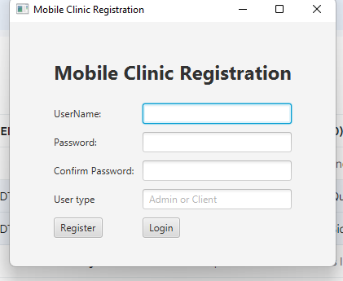
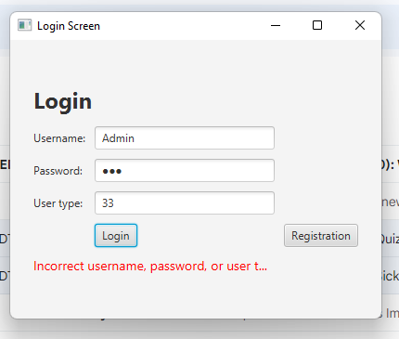
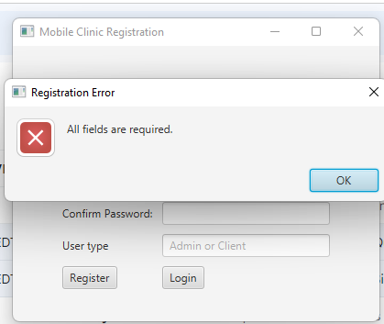
Program Features-Authentication
Registration and login screens to manage user accounts and access personalized features

Slide 7
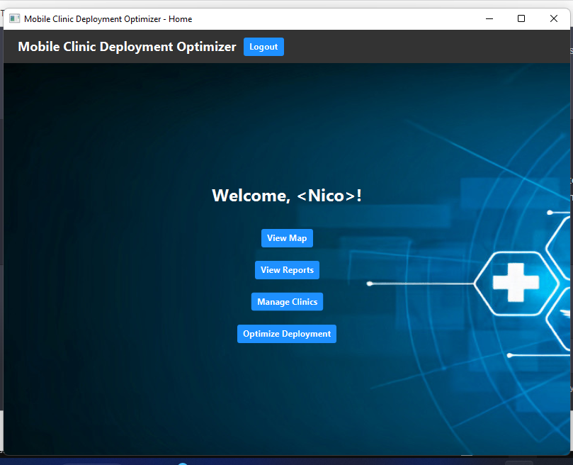
Program Features-Admin functions:
The program will provide the admin with several functions, such as adding new mobile clinics to the graph and deleting existing ones. Admins will be able to input information such as the name, location, and services offered by each mobile clinic. Additionally, the admin will be able to view the locations of the clinics on a map and monitor the clients who are registered and using the software. The program will also allow the admin to optimize the deployment of mobile clinics, ensuring that the clinics are deployed efficiently to serve the greatest number of people in need.

Slide 8
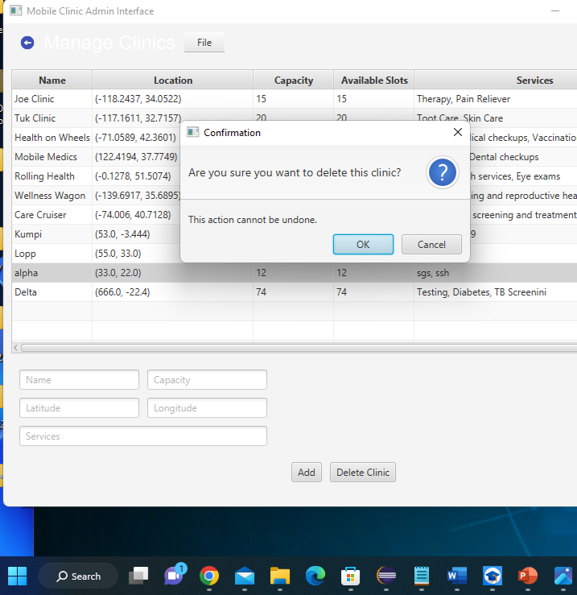
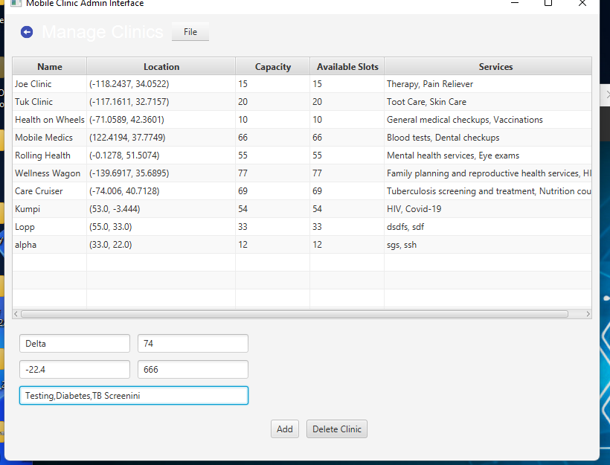
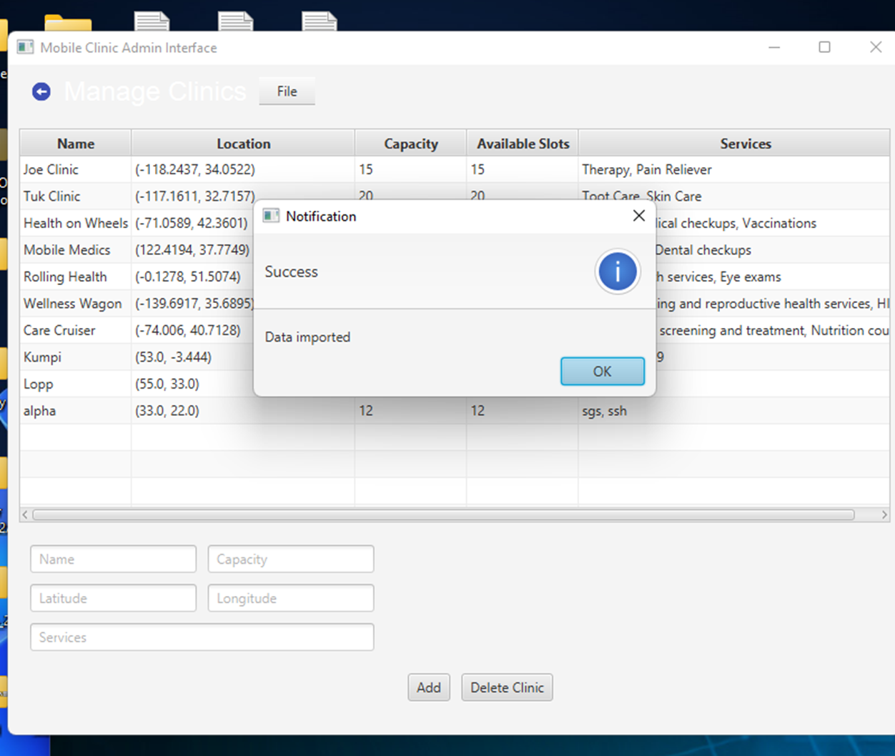
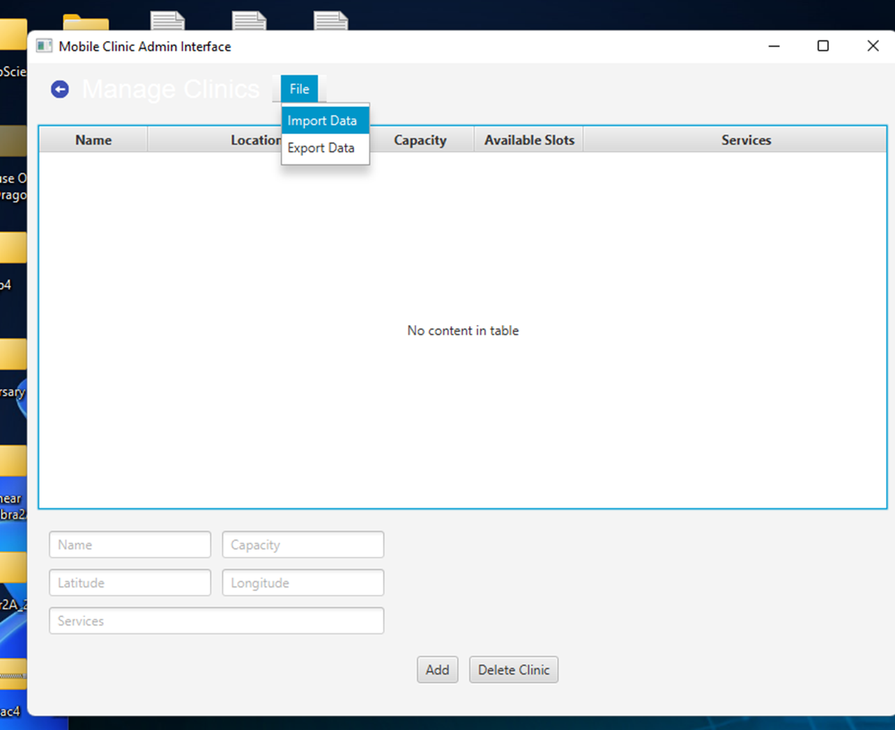
Import,Adding,Updating,and Deleting

Slide 9
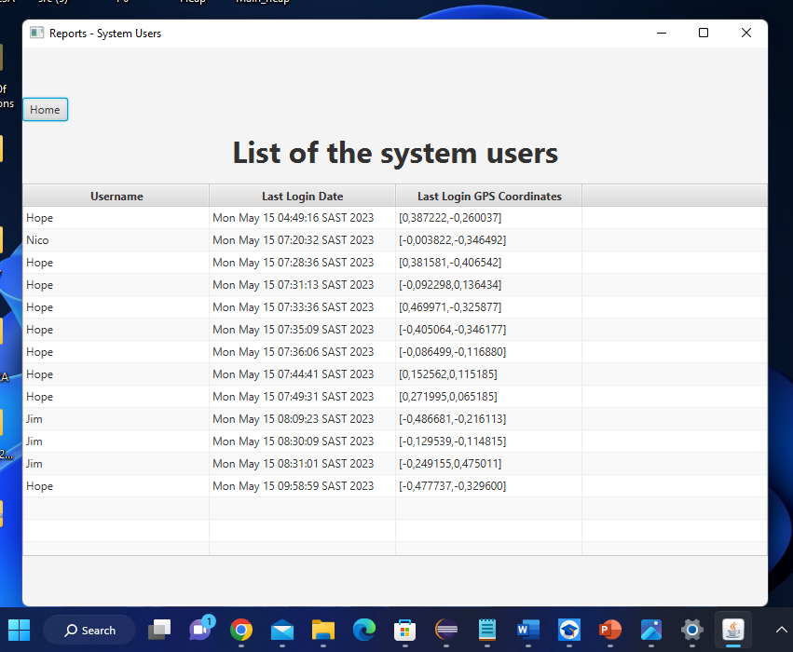
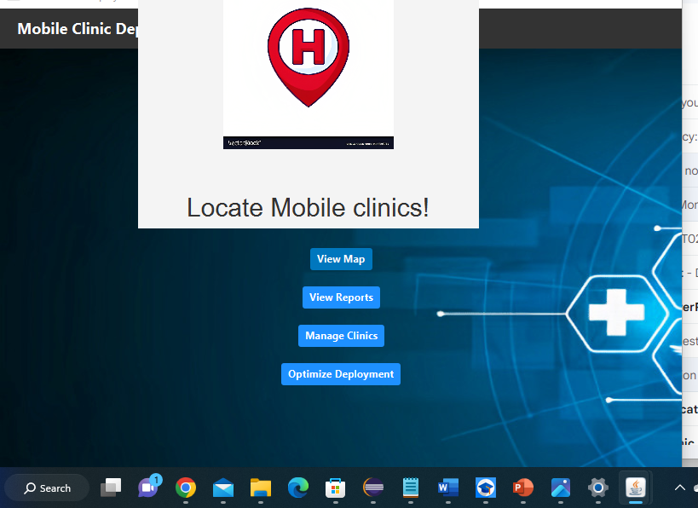
View Map and View Report

Slide 10
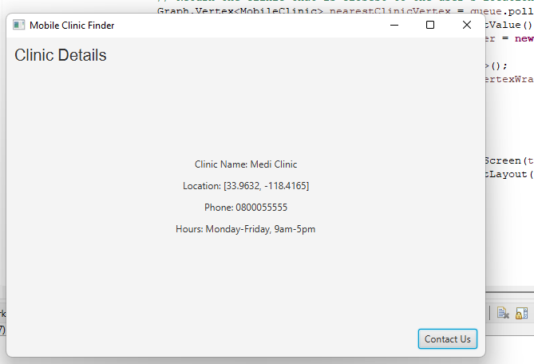
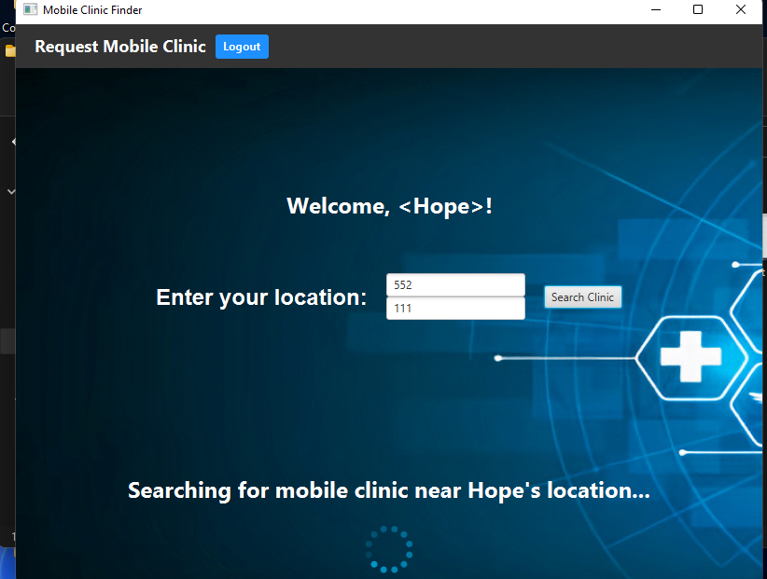
User functions:
User functions: Users will be able to search for the closest mobile clinic to their location using a search function. They will also be able to request a mobile clinic, specifying all details about the Mobile clinic. also, they can fill the contact us for any query.

Slide 11
Program Features
Graph implementation: The program use a graph data structure to store the mobile clinics and their connections. The graph algorithms Dijkstra's algorithm is used to find the shortest path between the user's location and the nearest mobile clinic. The program will store the information about the mobile clinics, user requests, and user accounts in a database. This will facilitate efficient retrieval and updating of information as needed.
User interface: The program have a user-friendly interface, allowing users to easily navigate and interact with the program. Additionally, the program will provide registration, login, and logout screens to manage user accounts and access personalized features.

Slide 12
Conclusion
The proposed solution is a feasible and effective way to improve access to healthcare services in rural areas.
It is a cost-effective solution that can help to improve the health and well-being of people in South Africa.

Slide 13

Conclusion
In conclusion, the healthcare challenges in rural areas of South Africa can be addressed by using graph algorithms to optimize the deployment of mobile clinics. By implementing a Java program that allows admins to add or delete mobile clinics and users to request a mobile clinic, we can improve access to healthcare services for those who need it most. The key features of the program, such as the search function for finding the closest mobile clinic, can further enhance the effectiveness of the program. By leveraging the power of graph algorithms, we can make a significant impact in improving healthcare services in remote areas of South Africa.

Slide 14
References
Statistics South Africa. (2021). Poverty trends in South Africa: An examination of absolute poverty between 2006 and 2015. https://www.statssa.gov.za/publications/Report-03-10-06/Report-03-10-062015.pdf
Naidoo, K., & Gathoo, V. (2018). Understanding the rural healthcare environment: A South African study. African Journal of Primary Health Care & Family Medicine, 10(1), e1-e8. https://doi.org/10.4102/phcfm.v10i1.1729
Dijkstra, E. W. (1959). A note on two problems in connexion with graphs. Numerische Mathematik, 1(1), 269-271. https://doi.org/10.1007/BF01386390
Hart, P. E., Nilsson, N. J., & Raphael, B. (1968). A formal basis for the heuristic determination of minimum cost paths. IEEE Transactions on Systems Science and Cybernetics, 4(2), 100-107. https://doi.org/10.1109/TSSC.1968.300136
Java documentation. (n.d.). Graphs. https://docs.oracle.com/en/java/javase/16/docs/api/java.base/java/util/Graph.html

